Slide 1
Data Structure Analysis and Design

Slide 2
Divide & Conquer

Slide 3
Plan of Lecture
Topics to be covered in Contact Session:
Introduction to the Divide and conquer Strategy
Algorithm and analysis
Merge Sort
Binary Search
Quick Sort
Integer Multiplication

Slide 4
Introduction to Divide and Conquer
What is Divide and Conquer Strategy
Factors affecting:
Design Choice
Number of Sub Problems.
Choice of granularity of Atomic Problems.
Examples:
Merge Sort
Binary Search
Quick Sort
……..

Slide 5
Merge Sort
The merge sort algorithm is defined recursively:
If the list is of size 1:
it is sorted—we are done;
Otherwise:
Divide an unsorted list into two sub-lists,
Sort each sub-list recursively using merge sort,
Merge the two sorted sub-lists into a single sorted list
Question: How quickly can we recombine the two sub-lists into a single sorted list?

Slide 6
Merge Sort
Non In-Place sort (Uses extra space)
2T(n/2) | + | N
Break |  | Merge
15 | 13 | 16 | 3 | 7 | 82 | 8 | 10 | 25

Slide 7
The Algorithm
The algorithm:
Split the list into two approximately equal sub-lists
Recursively call merge sort on both sub lists
Merge the resulting sorted lists
void merge_sort( Type *array, int first, int last )
{
int midpoint = (first + last)/2;
merge_sort( array, first, midpoint );
merge_sort( array, midpoint, last );
merge( array, first, midpoint, last );
}

Slide 8
Run-time Analysis of Merge Sort
Thus, the time required to sort an array of size n > 1 is:
Time required to Sort the first half,
Time required to Sort the second half
Time required to Merge the two lists
That is:
Simplifying this, we have n + n lg(n)
The run time is Θ(n log (n))

Slide 9
Run-time Summary
The following table summarizes the run-times of merge sort
Case | Run Time | Comments
Worst | Θ(n log (n)) | No worst case
Average | Θ(n log (n))
Best | Θ(n log (n)) | No best case

Slide 10
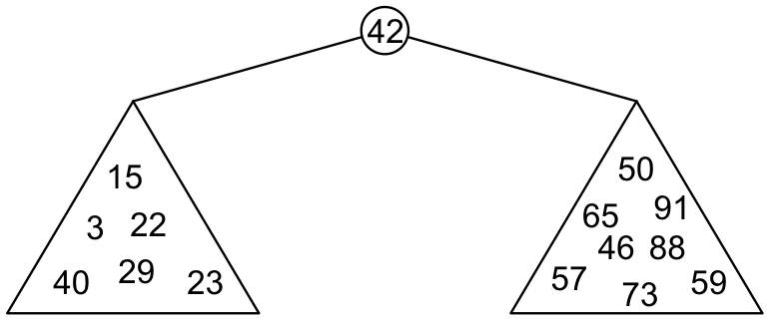
Binary Search Trees
Graphically, we may show the relationship as
Each of the two sub-trees will themselves be binary search trees

Slide 11
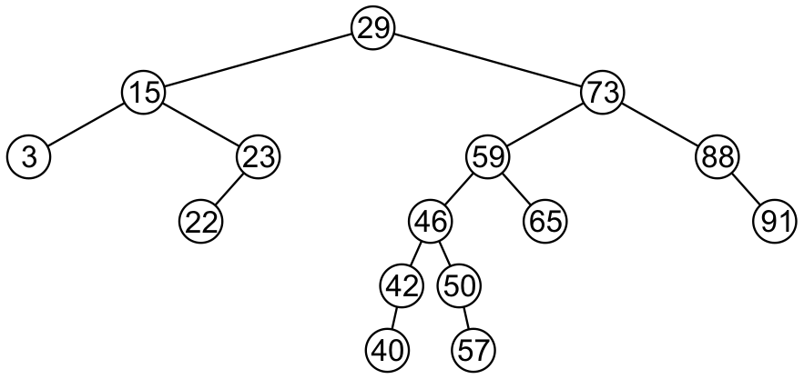
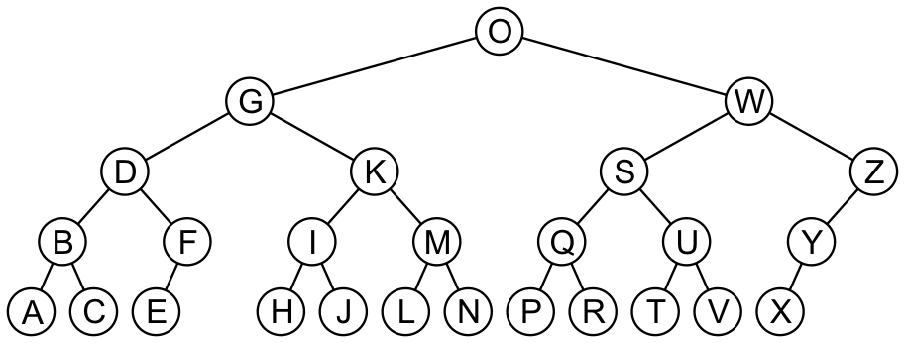
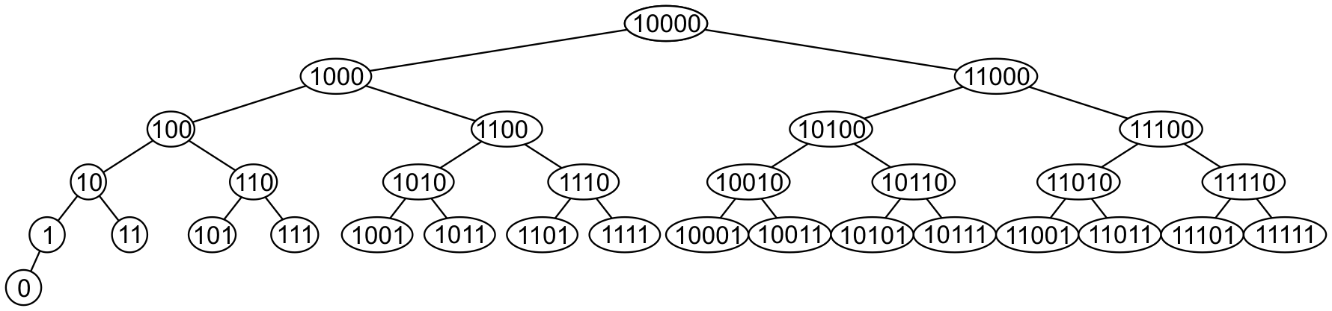
Examples
Here are other examples of binary search trees:

Slide 12
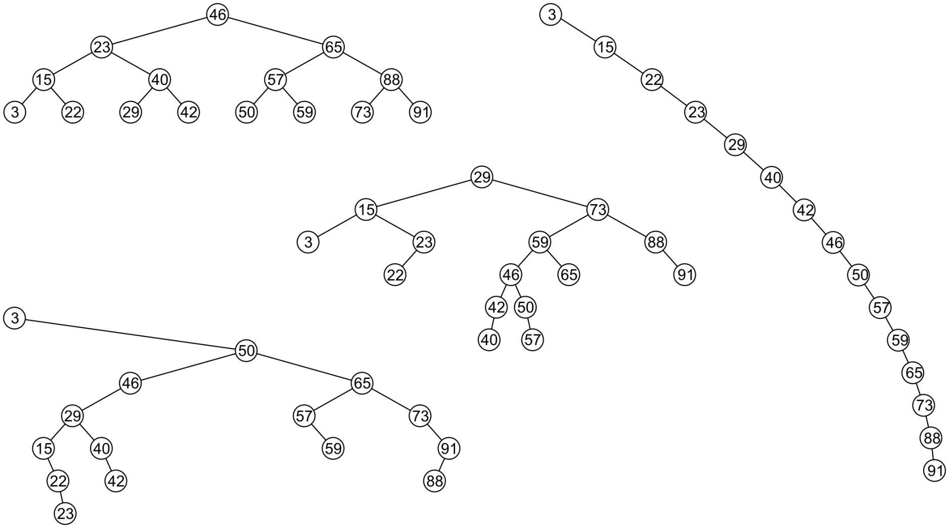
Examples
All these binary search trees store the same data

Slide 13
Quick Sort
A divide-and-conquer algorithm
Divide: partition array into 2 subarrays such that elements in the lower part <= elements in the higher part
Conquer: recursively sort the 2 subarrays
Combine: trivial since sorting is done in-place

Slide 14
Quick Sort
Inpalce sort
Average case O(n log n)
Worst case O(n²)
Partition of set in two halves
Best case :-> in two equal half
Worst case :->
2T(n/2) | + | n
Partition |  | Merge
T(1) | + | T(n-1) | + | n
Partition |  |  |  | Merge

Slide 15
Partitioning
Linear time partitioning procedure
15 | 13 | 16 | 3 | 7 | 82 | 8 | 10

Slide 16
Integer Multiplication
For multiplying big integers, which cannot be handled directly by the arithmetic unit of a single processor.
Data security (big integers are used in encryption schemes)
For integer multiplication, the number of bits has to be an integral multiple of 2.
If not, ZERO’s are added to it.

Slide 17
Decimal Number multiplication
9846*4679
Time complexity is O(n²)
 |  |  |  | 9 | 8 | 4 | 6
 |  |  | * | 4 | 6 | 7 | 9
 |  |  | 8 | 8 | 6 | 1 | 4
 |  | 6 | 8 | 9 | 2 | 2 | X
 | 5 | 9 | 0 | 7 | 6 | X | X
3 | 9 | 3 | 8 | 4 | X | X | X
4 | 6 | 0 | 6 | 9 | 4 | 3 | 4

Slide 18
Binary Number multiplication
11101010*10111001
Time complexity is O(n²)
 | 1 | 10 | 10 | 11 | 10 | 10 | 10 | 10 | 1 | 0 | 0 | 0 | 0 | 0
 |  |  |  |  |  |  |  | 1 | 1 | 1 | 0 | 1 | 0 | 1 | 0
 |  |  |  |  |  |  | * | 1 | 0 | 1 | 1 | 1 | 0 | 0 | 1
 |  |  |  |  |  |  |  | 1 | 1 | 1 | 0 | 1 | 0 | 1 | 0
 |  |  |  |  | 1 | 1 | 1 | 0 | 1 | 0 | 1 | 0 | X | X | X
 |  |  |  | 1 | 1 | 1 | 0 | 1 | 0 | 1 | 0 | X | X | X | X
 |  |  | 1 | 1 | 1 | 0 | 1 | 0 | 1 | 0 | X | X | X | X | X
 | 1 | 1 | 1 | 0 | 1 | 0 | 1 | 0 | X | X | X | X | X | X | X
1 | 0 | 1 | 0 | 1 | 0 | 0 | 1 | 0 | 0 | 0 | 1 | 1 | 0 | 1 | 0

Slide 19
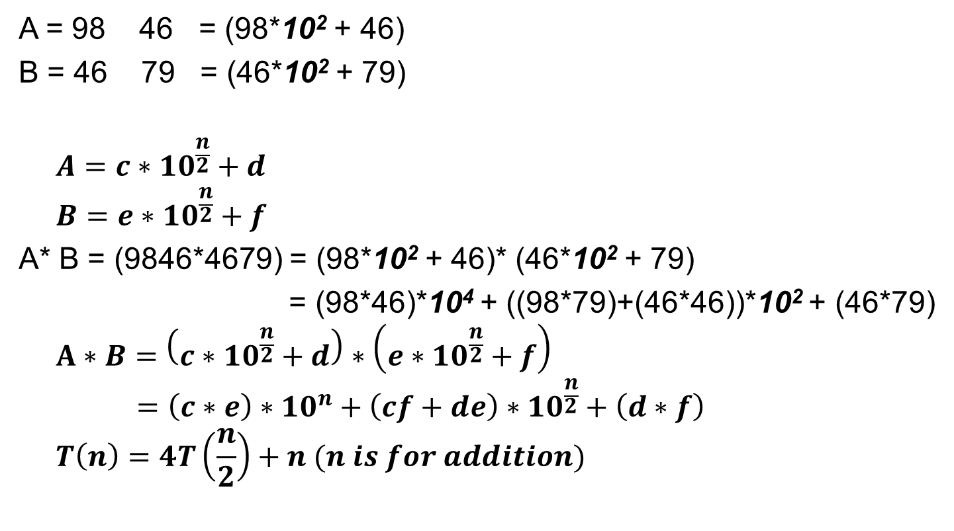
Decimal Number multiplication (D&C)
c
n = 4
d
A = 98 46 = (98*10² + 46)
B = 46 79 = (46*10² + 79)
$$A=c∗{10}^{\frac{n}{2}}+d$$
$$B=e∗{10}^{\frac{n}{2}}+f$$
A* B = (9846*4679) = (98*10² + 46)* (46*10² + 79)
= (98*46)*10⁴ + ((98*79)+(46*46))*10² + (46*79)
$$A∗B=\left(c∗{10}^{\frac{n}{2}}+d\right)∗\left(e∗{10}^{\frac{n}{2}}+f\right)$$
$$=\left(c∗e\right)∗{10}^{n}+\left(cf+de\right)∗{10}^{\frac{n}{2}}+\left(d∗f\right)$$
$$T\left(n\right)=4T\left(\frac{n}{2}\right)+n (n is for addition)$$
e
f

Slide 20
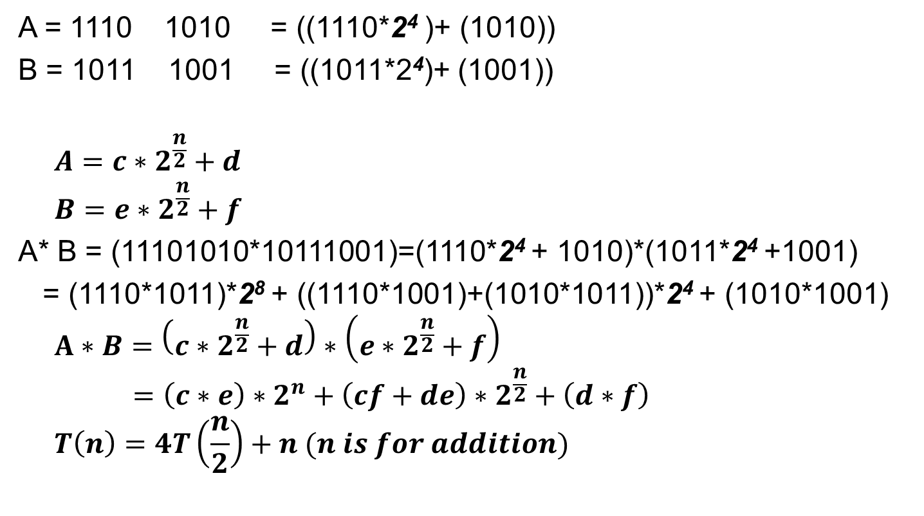
Binary Number multiplication (D&C)
c
n = 8
d
A = 1110 1010 = ((1110*2⁴ )+ (1010))
B = 1011 1001 = ((1011*2⁴)+ (1001))
$$A=c∗2^{\frac{n}{2}}+d$$
$$B=e∗2^{\frac{n}{2}}+f$$
A* B = (11101010*10111001)=(1110*2⁴ + 1010)*(1011*2⁴ +1001)
= (1110*1011)*2⁸ + ((1110*1001)+(1010*1011))*2⁴ + (1010*1001)
$$A∗B=\left(c∗2^{\frac{n}{2}}+d\right)∗\left(e∗2^{\frac{n}{2}}+f\right)$$
$$=\left(c∗e\right)∗2^{n}+\left(cf+de\right)∗2^{\frac{n}{2}}+\left(d∗f\right)$$
$$T\left(n\right)=4T\left(\frac{n}{2}\right)+n (n is for addition)$$
e
f

Slide 21
Binary Number multiplication (D&C)

Slide 22
Graphs

Slide 23
Graphs
Terms and Definitions:
Nodes, Edges, Labeling, Weights, Paths…
Representation & Storage
Edge List,
Adjacency list,
Adjacency Matrix
Graph Traversals
BFS
DFS

Slide 24
Graphs
Tree
Binary Tree
Spanning Tree
Minimum Spanning Tree
Shortest Path

Slide 25
Greedy Algorithms

Slide 26
Thank You

